Slide 1
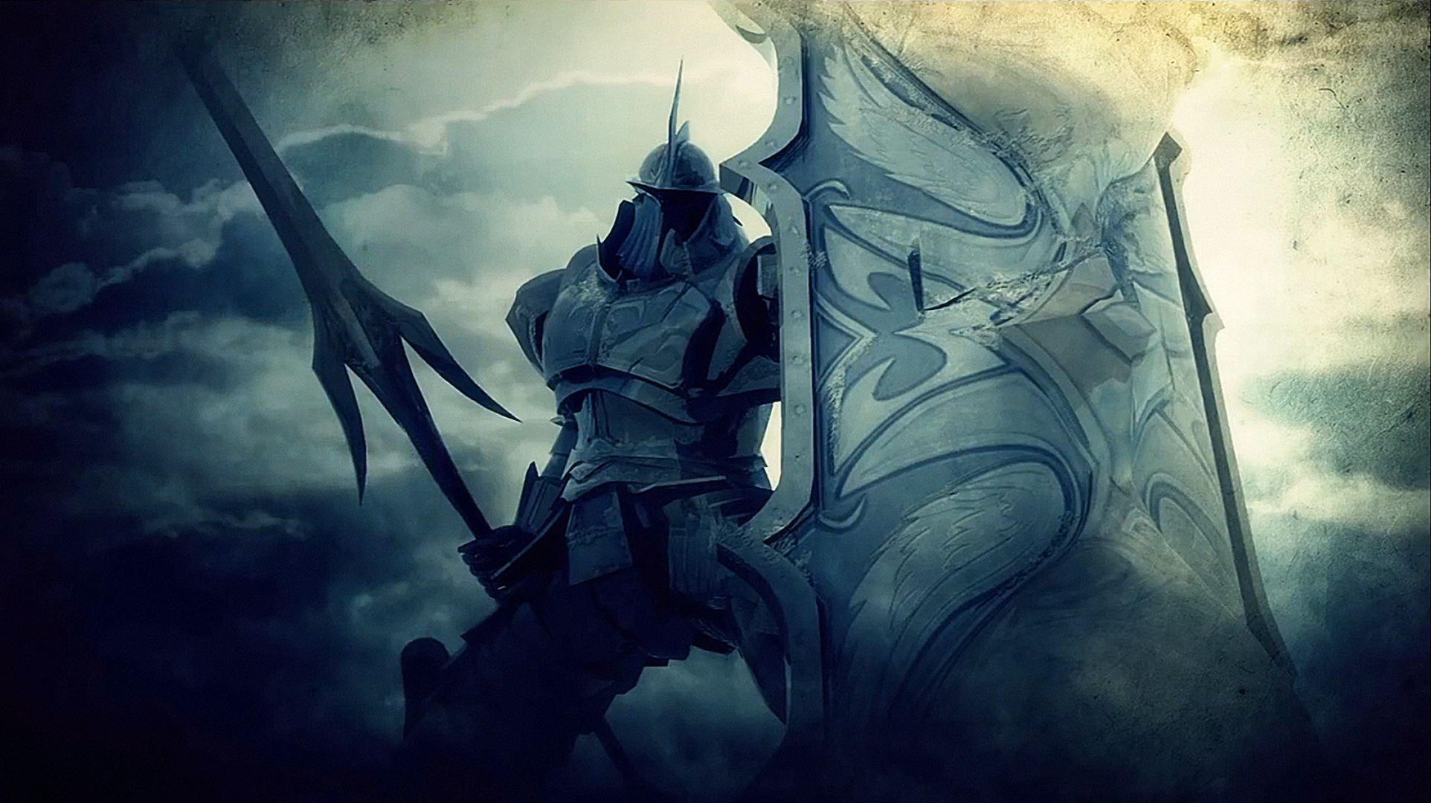

Team Antitarra
Presents:
RPG Game “Demon Invasion”

Slide 2
Demon Invasion
Demon Invasion is a RPG style game where the main character moves across a field and interacts with objects like trees, rocks, AI objects
The main character could be different type – Magician, Templar, Agent, Sergeant
The computer opponents could be different types of demons (each defined in his separate class)
There are different items that could be used – shields, potions, ammo

Slide 3
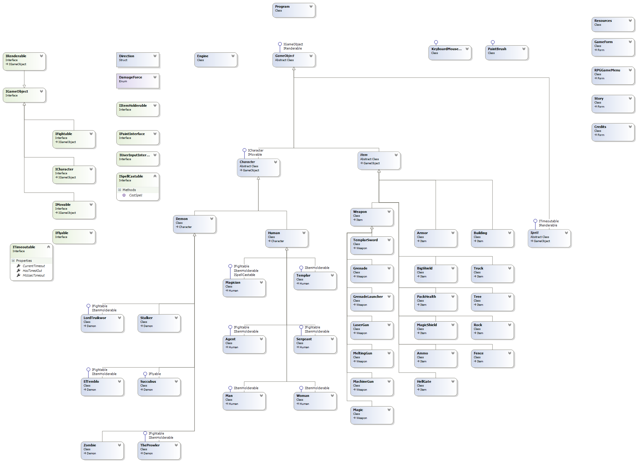
Demon Invasion – Class Diagram

Slide 4
Team “Antitarra” @ SoftUni
Людмил Гр. (LyudG)
Слави Коен (slavi.koen)
Стоян Стоянов (Stoyan.Stoyanov)
Слави Георгиев (aslv1)
Георги Ангелов (georgeangelov93)
Анатоли Асенов (anatoli_asenov)
https://github.com/TeamAntitarra/TeamProject-RPGGame

